Slide 1
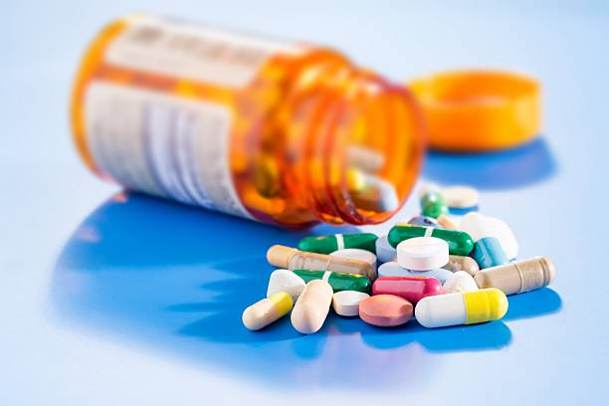

Medical Prescription Abuse Prevention
Team Technoholics

Slide 2
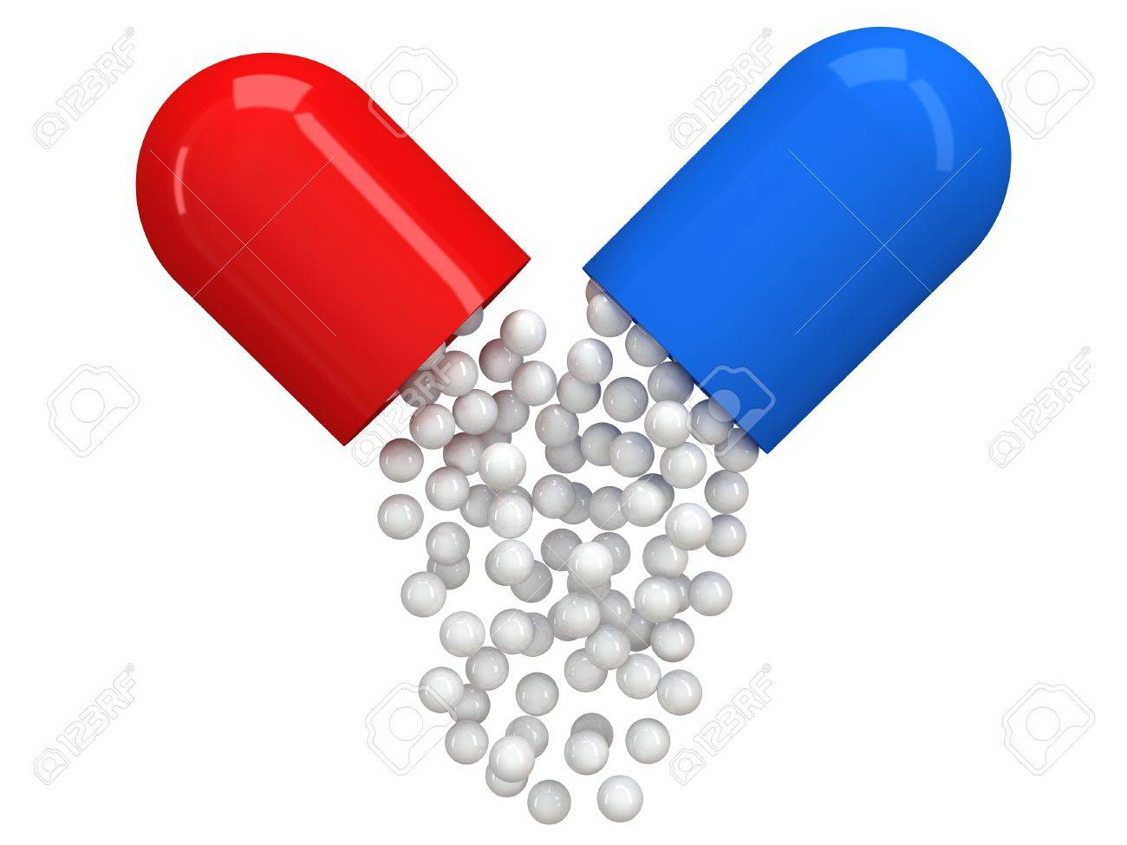
Why Prescription Abuse Prevention?
Beyond Intended Dosage Fraudulent Prescriptions
Duplicate Selling
Doctor Shopping
Side Effects – Nausea, Dizziness, Insomnia, Weight, Headaches like Anti Depressents, HDrugs
Insurance Company Loss
Notes:
Patients are using medical prescription to get medications beyond the intended dosage because they are able to use the prescription with multiple pharmacies.At present the pharmacies do not know how of medication in a prescription has already been purchased by the patient.This not only reduces the effectiveness of treatment but also increase side effects and also insurance companies suffer losses as they pay the medication bills for patients.How to detect or prevent this abuse?So it is pharmacy centric only...

Slide 3
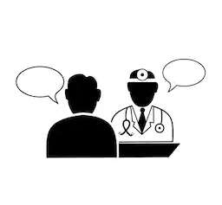

How it works?

Slide 4
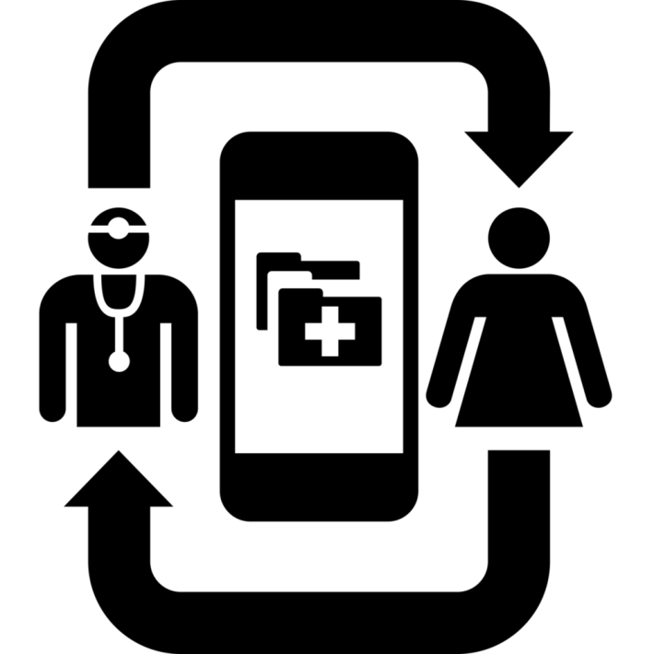
Doctor enters prescriptions
Generates Unique <Visit ID>
<Visit ID> is submitted to pharmacy.
Medicines prescribed in visit are provided and same is updated
Control:
Unique <Visit ID> helps to avoid duplicate prescriptions or fraudulent prescription or prescription falsifications.
<Visit History> is prevented and doctor shopping can be noticed.

Slide 5
Future Scope
Spring Integration allows to scale to Android/IOS
Chat functionality can be added.
Connection to Insurance department
Connection to Inventory System
Reason for reproviding

Slide 6
Technologies
Frontend
Angular js
Node.js
Backend
JAVA 8
Spring Integration
Hibernate/JPA
Apache-tomcat-8
Database
My SQL

Slide 7
